Slide 1
IMU Development
Rocket Avionics Package, ENGR301
Luke Davia

Slide 2
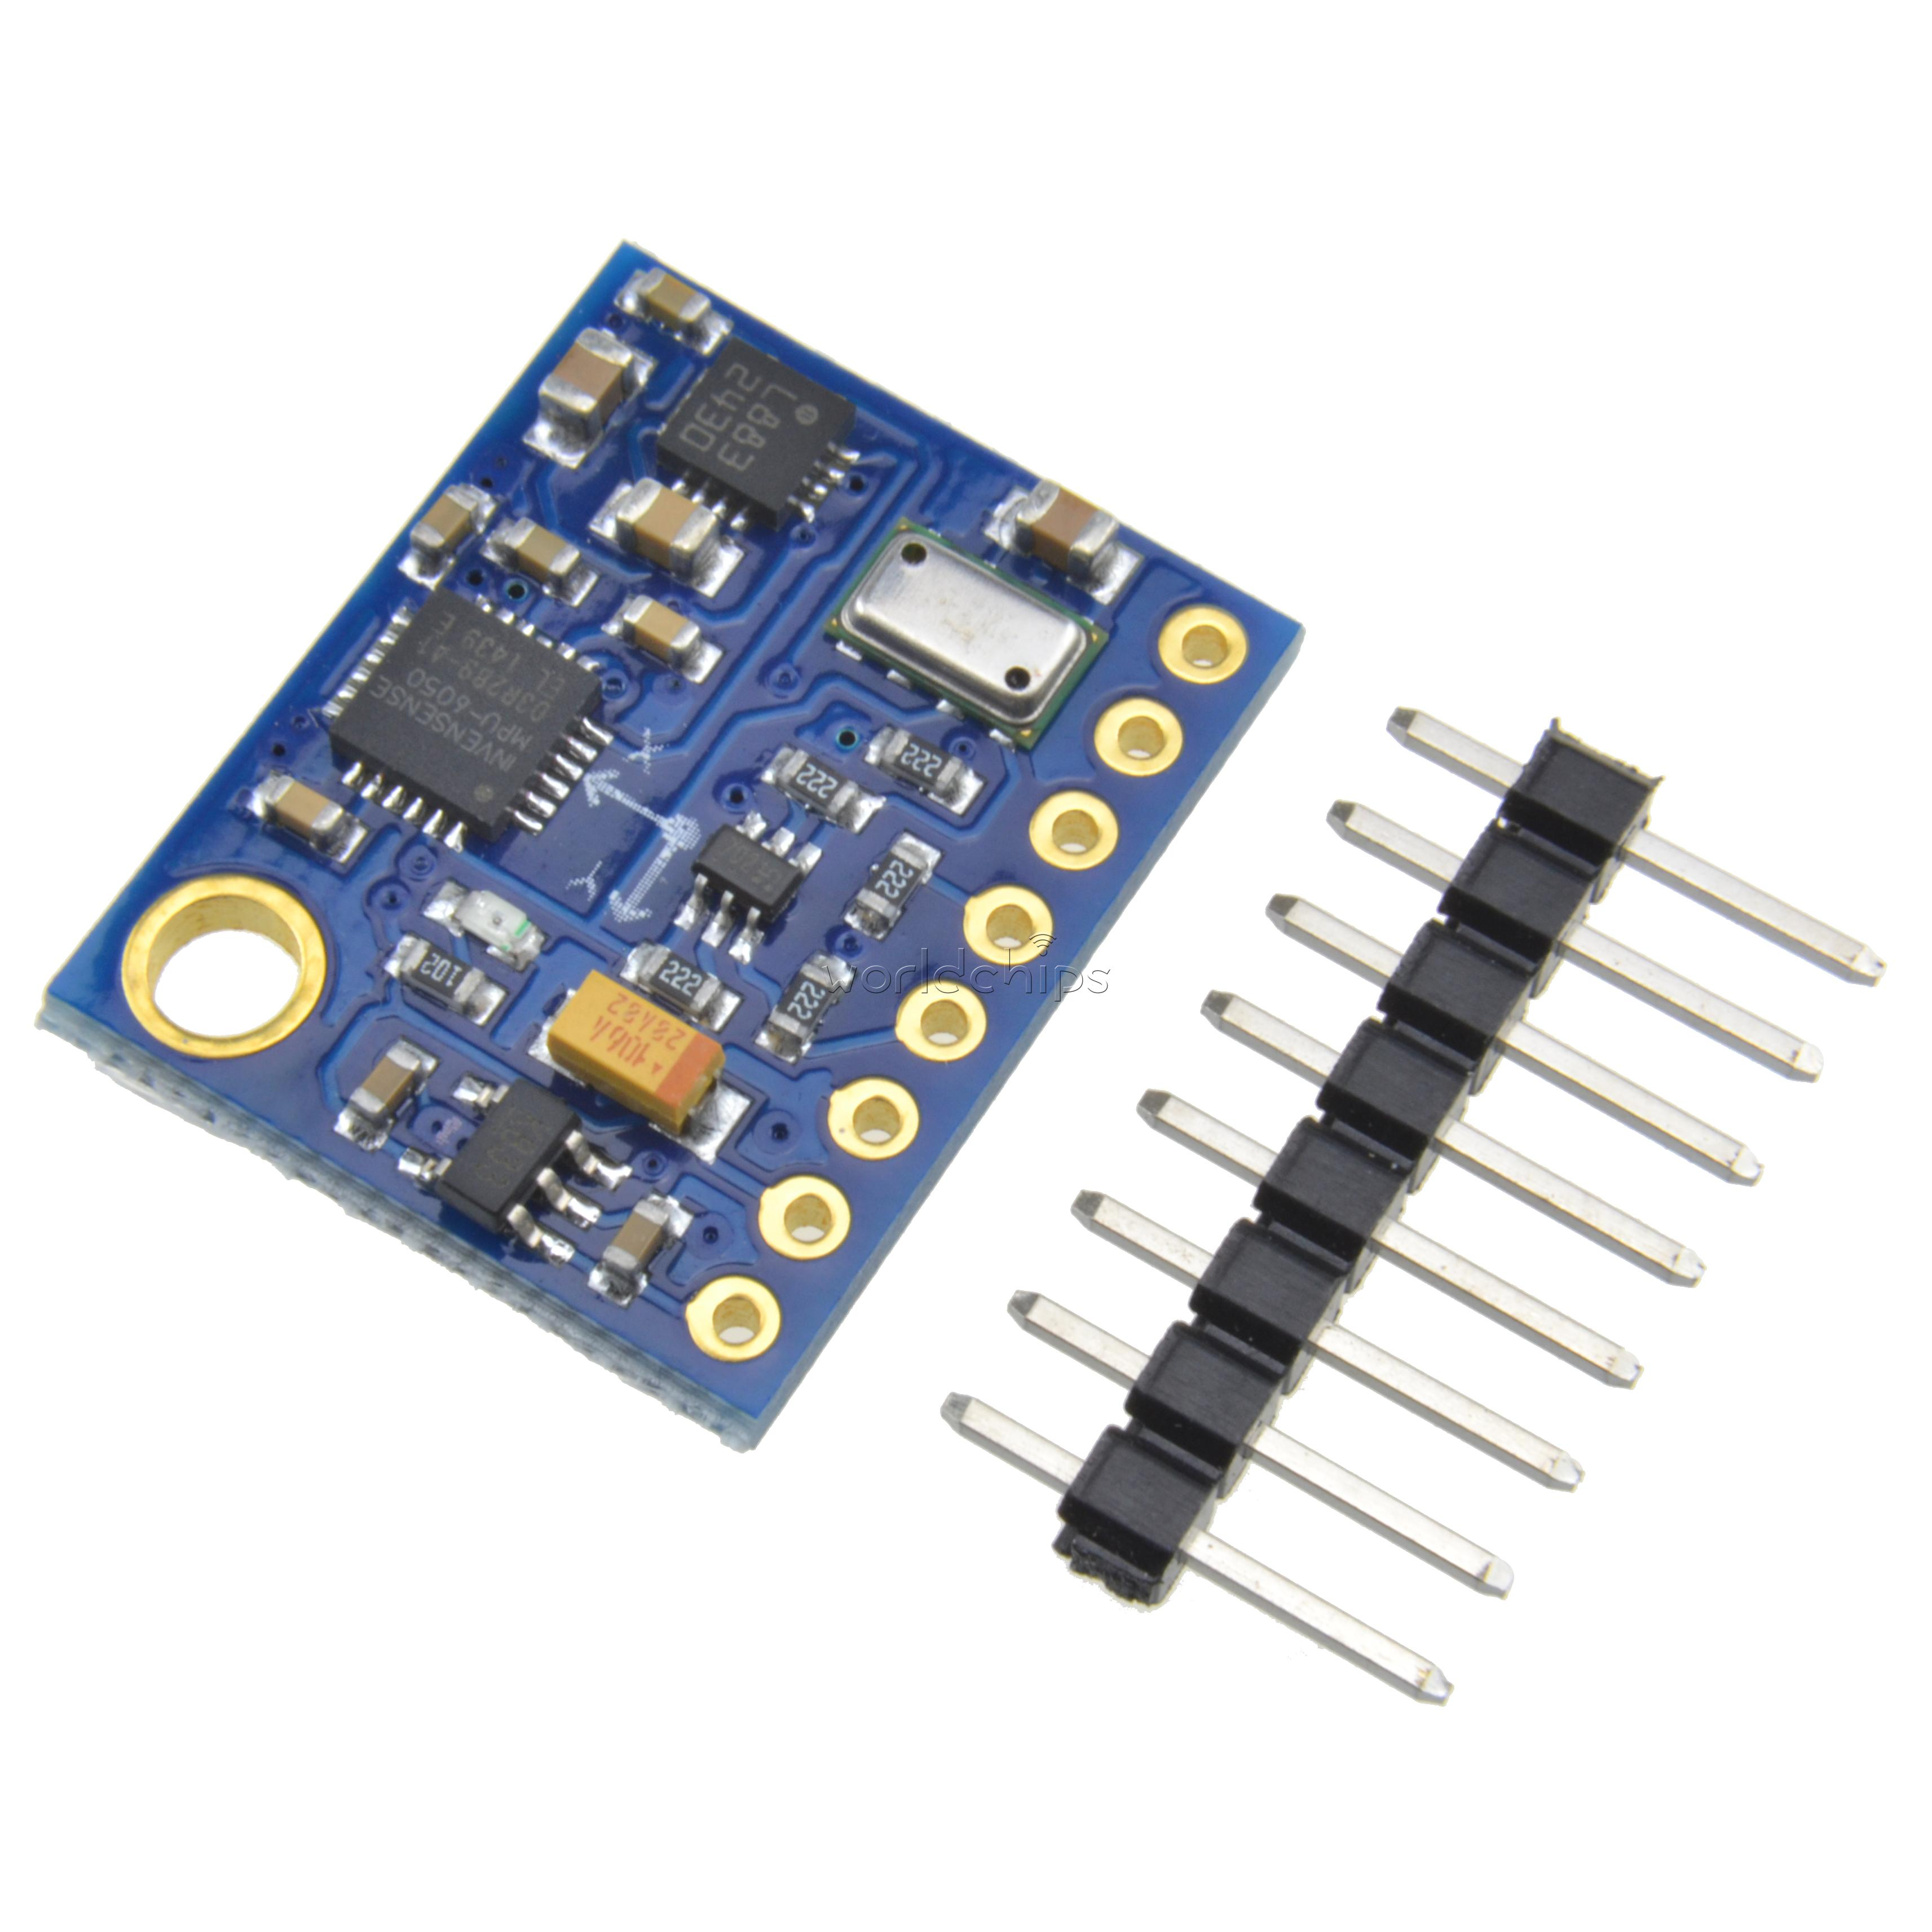
What is an IMU?
Luke Davia
An IMU, also known as an Inertial Measurement Unit, is an electronic component that measures intrinsic properties related to orientation.
Generates rates of change w.r.t. acceleration, gyroscopic, & magnetic data in the (x,y,z) axes.
Quaternion mathematics can be applied to produce positional pitch, roll, & yaw data.

Slide 3
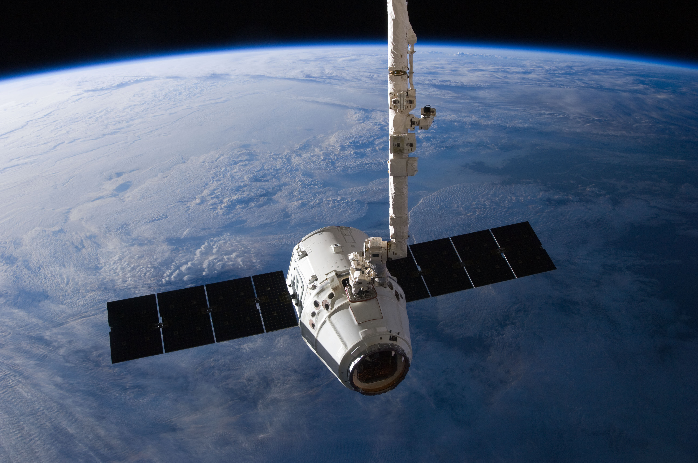
Why do we need an IMU?
Luke Davia

Slide 4
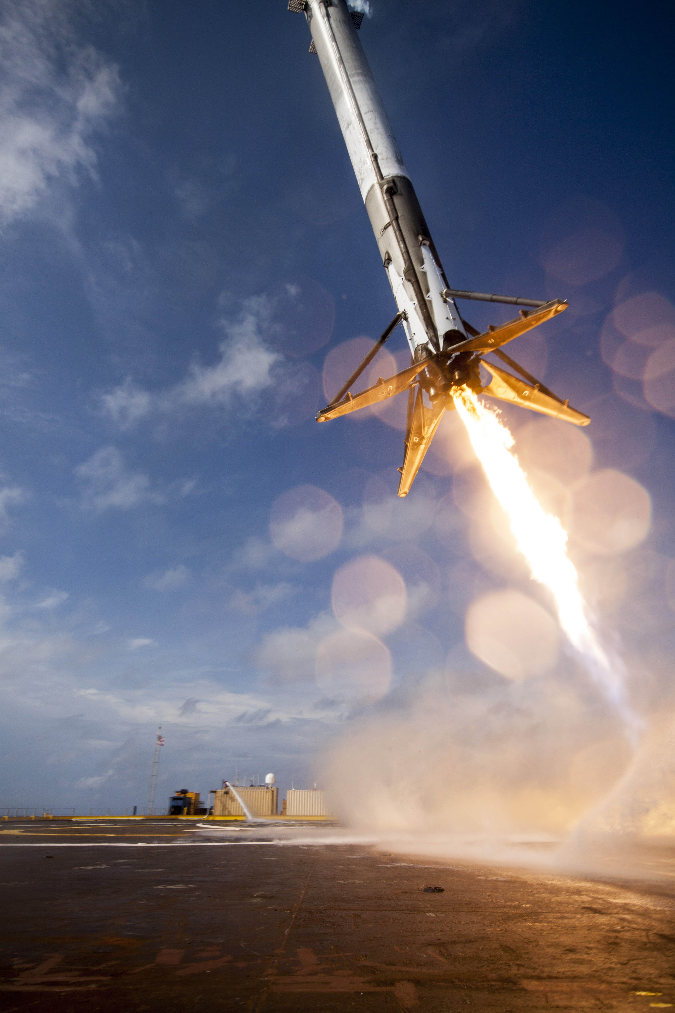
Rockets need a source of orientation data!
Luke Davia

Slide 5
Why do we need an IMU?
IMU forms a subset of the overall GNC (Guidance, Navigation, & Control) architecture for the avionics package.
Positional, change, and rate of change data is fed from the IMU as inputs to the gimballing motors (in our case, servos) to correct the vehicle trajectory.
Can additionally act to detect launch events (liftoff, apogee, landing).

Slide 6
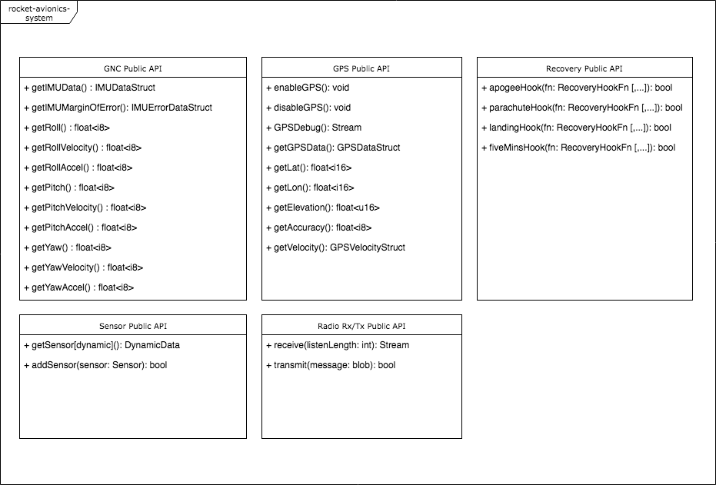
How the IMU integrates into the rocket avionics package
Developed as an atomic subcomponent of the overall package.
Pre-defined software architecture guarantees an IMU API for other components.
Software architecture developed in Formal Design Document. Can be revised as requirements change.

Slide 7
IMU procurement & selection
Procurement of vehicle components was performed by Jonathan.
Evaluation consisted of price, accessibility, and available support & library quality.
Latter is important if you want to get it working…
Settled on IMU used last year (MPU9250) due to prior code & component availability.

Slide 8
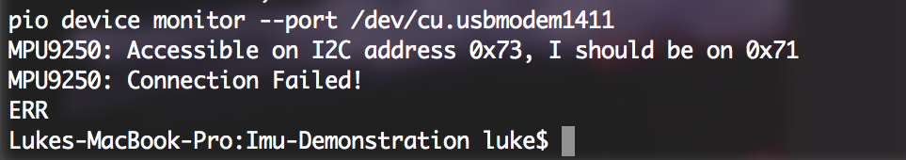
Expectations vs. Reality
Would’ve liked to have made more progress by now. IMU API contract should’ve been completed.
Library quality & documentation is poor at best.
Always uncertain about whether you’ve made a programming error, or your $3 IMU chip is out-of-spec. Sometimes it is!
Positive: overall development path currently not constrained by IMU.

Slide 9
IMU Software Development Pt. 1
Software development of IMU was constrained by procurement selection, hard to write chip & library agnostic code without a contract/interface to guarantee against.
Can only develop high level architecture in pseudo-code.

Slide 10
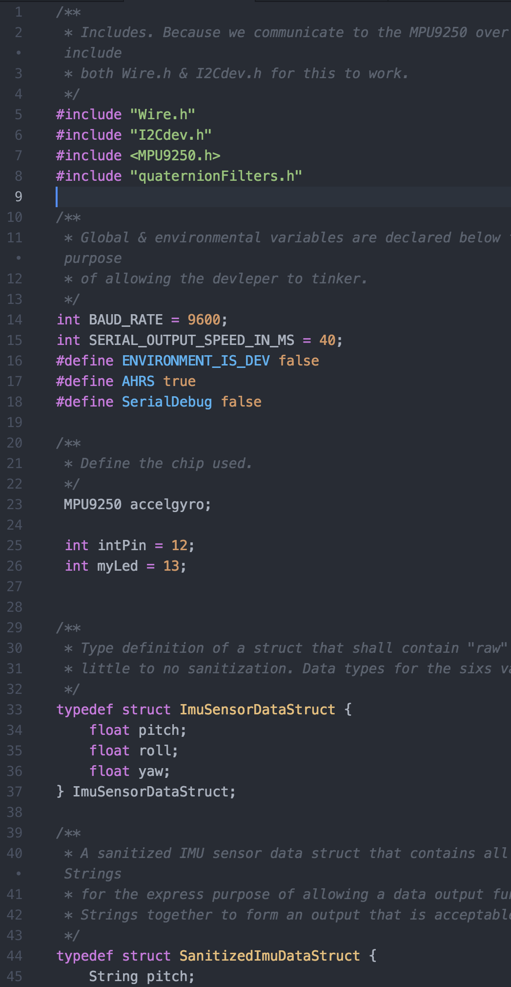
IMU Software Development Pt. 2
Luke Davia
Atom with PlatformIO used as an Integrated Development Environment.
Easy building and uploading of code to Teensy/Arduino, reducing turnaround time to seconds.
Adhering to industry best-practices where possible: docblocked code, consistent naming, following patterns in other libraries.

Slide 11
How the IMU software meets performance quality metrics
Performance Quality Metrics defined in original Project Management Plan.
Currently able to iterate at 25+ times per second with debugging enabled on an Arduino running at 16MHz. Work in progress.
Will be significantly faster on our chosen board, Teensy 3.6 (180MHz).
Iteration time of 1ms / 1000 times per second desired.
Tight IMU feedback needed to allow for GNC adjustments before large changes in vehicle orientation take place (this sounds nicer than “crashing into the ground”).

Slide 12
How the IMU software meets correctness quality metrics
Currently outputs so-so data, but type of values meets original contract (struct containing orientation data as floats representing angle).
Libraries themselves often have undocumented features, important to adhere to only the portions of code you know work. Lesson 1: View issues log on GitHub to determine software quality.

Slide 13
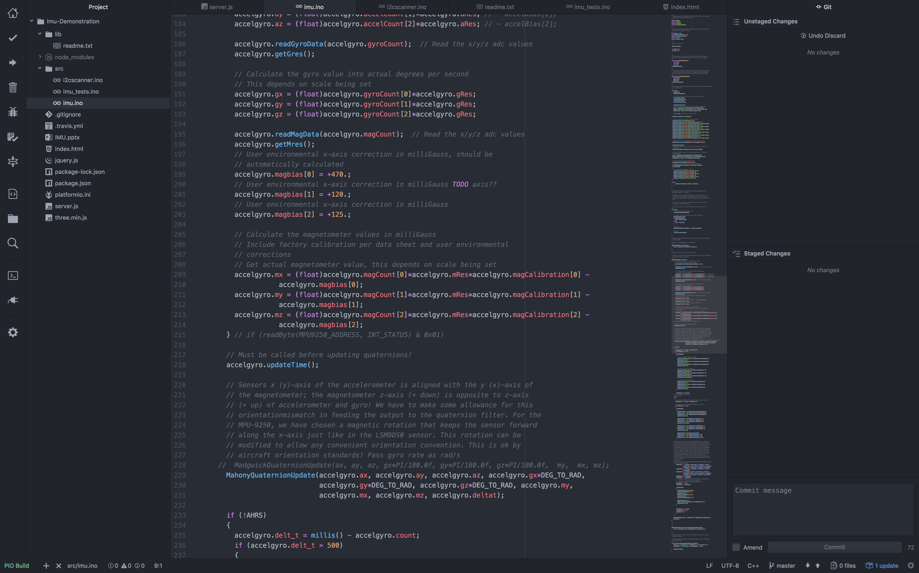
Luke Davia

Slide 14
Documentation
Why document code? Humans suck at parsing. Any team member should be able to work on code in a couple of minutes.
All functions docblocked, with @params & @returns information.
Libraries used included at top of files, including source and description of what it does.
Lower level languages are harder to understand, this isn’t Javascript.

Slide 15
Demonstration
if (demonstration-works) {
MPU9250 9DOF chip is attached to an Arduino.
Quaternion math converts raw IMU data into positional pitch/roll/yaw information.
Data is transmitted through Serial monitor, Node.js webserver listens and JSON-serializes orientation data.
Client makes 10 requests/s, data is shown on screen & WebGL wireframe cube is updated to visually represent Arduino orientation in 3D space.
} else {
print(“:/”);
Powerpoint.showNextSlide();
}

Slide 16
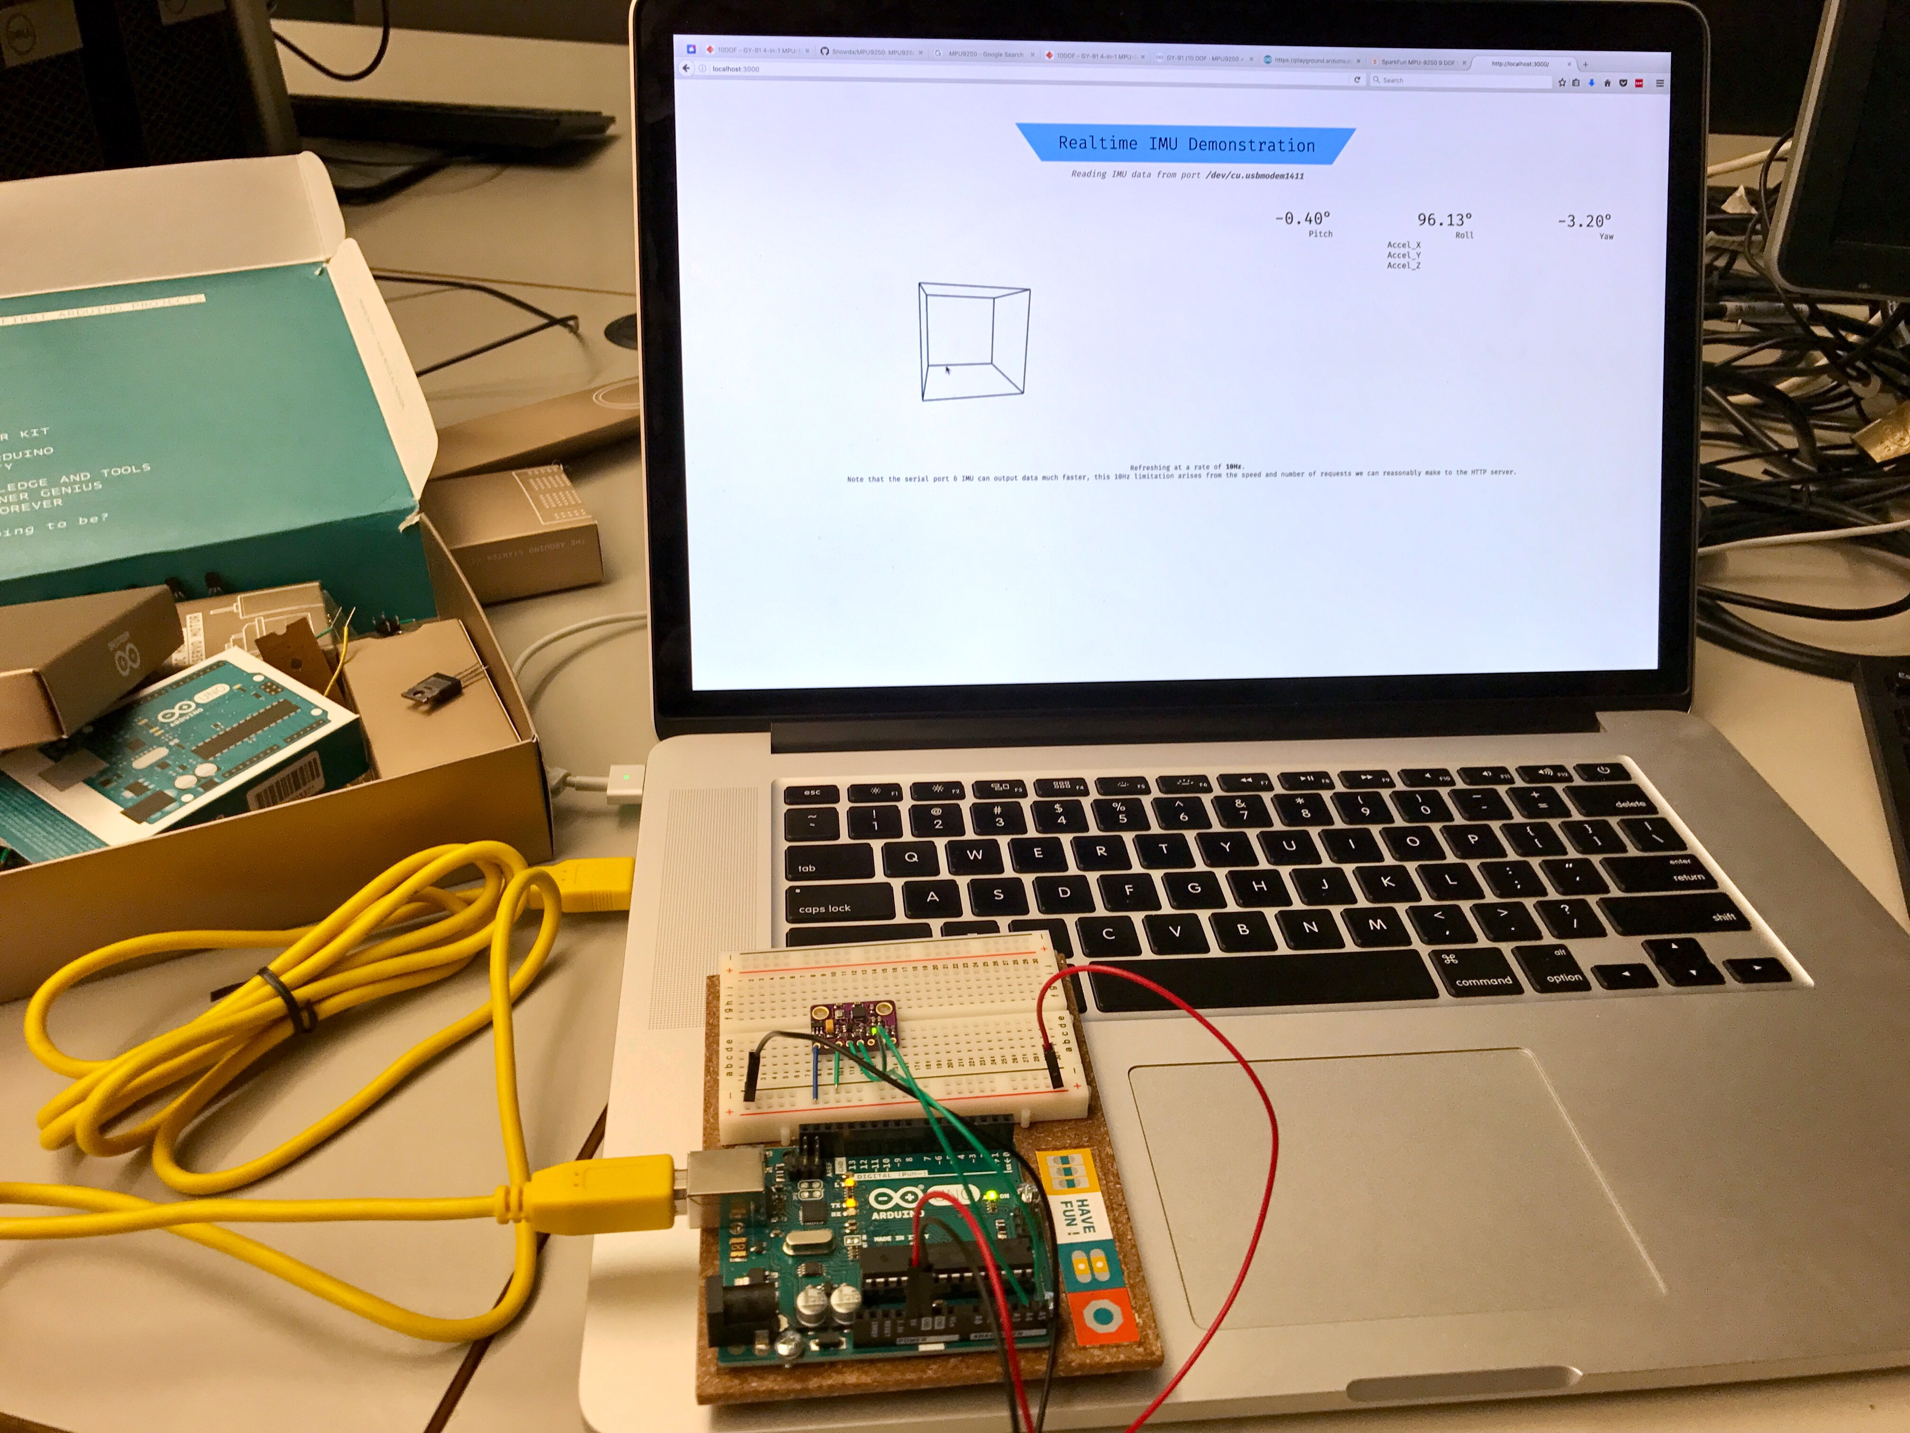
Luke Davia

Slide 17
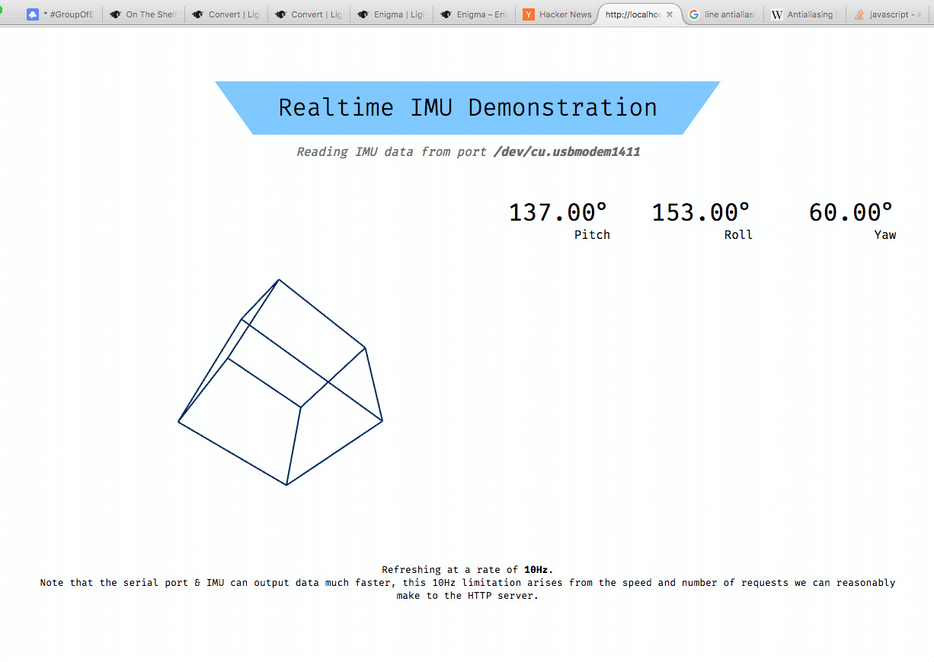
Luke Davia

Slide 18
What’s next…
Possibility for drop-in replacement of current IMU to acquire more accurate data & avoid faults. Looking at a number of options.
Continuation of software development to tighten response time & accuracy; and remove any errors.
Continue documentation of current architecture to reduce difficulty curve for other team members needing to interface with data.
Integration of IMU data into GNC PID-loops to control vehicle servos.

Slide 19
References & Sources
Image of IMU, courtesy Alibaba.
“Dragon berthing at the ISS”, courtesy NASA. https://www.nasa.gov/images/content/655515main_iss031e079326_full.jpg
“CRS-6 landing on Just Read The Instructions”, courtesy SpaceX. https://www.flickr.com/photos/spacex/17369785125
Image of Software Architecture created by Luke.
Image of IMU connection failure created by Luke.
Image of IMU code created by Luke.
Code exemplars created by Luke.
Arduino+Laptop & Demonstration screen created by Luke.

